Slide 1
CSC6032 – Advanced Operating Systems
Prof. Yeh-Ching Chung
School of Data Science
Chinese University of Hong Kong, Shenzhen

Slide 2
虛擬化技術 Virtualization Techniques
Hardware Support Virtualization
MR-IOV

Slide 3
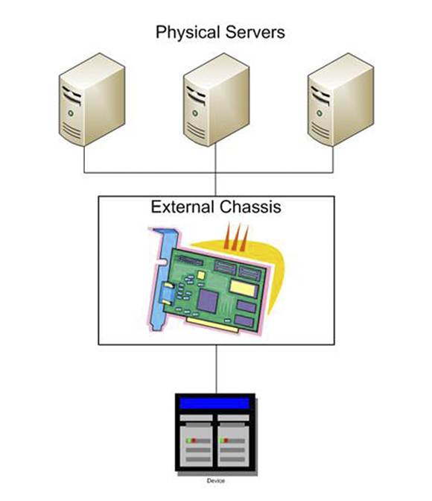
MR-IOV Introduction
Multiple servers & VMs sharing one I/O adapter
Bandwidth of the I/O adapter is shared among the servers
The I/O adapter is placed into a separate chassis
Bus extender cards are placed into the servers

Slide 4
MR-IOV Topology
MR components group to create Virtual Hierarchies (VH)
Virtual Hierarchy = a logical PCIe hierarchy within a MR topology.
Each VH typically contains at least one PCIe Switch.
Extends from a RP to all its EPs
Each VH may contain any mix of Multi-Root Aware (MRA) Devices, SR-IOV Devices, Non-IOV Devices, or PCIe to PCI/PCI-X Bridges.
The MR-IOV topology typically contains at least one MRA Switch

Slide 5
MR-IOV Topology
Root Complex (RC)
Root Complex (RC)
Root Complex (RC)
Root Complex (RC)
Root
Port (RP)
Root
Port (RP)
Root
Port (RP)
Root
Port (RP)
MRA
Switch
MRA
Switch
PCIe
Switch
PCIe to PCI Bridge
MRA PCIe
Device
SR-IOV PCIe
Device
PCIe
Device
PCI/PCI-X
Device

Slide 6
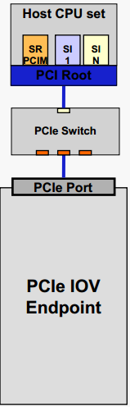
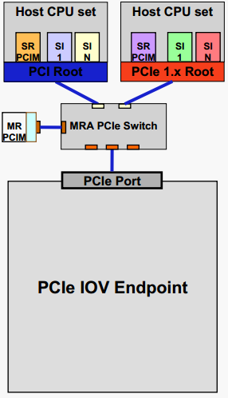
Topology Overview and Terms
SR Topology | Multi-Root Topology | Terms
 |  | Single Root (SR) IOV Overview, Only has one Root. Switches only need to support PCIe base functionality. To make full use of IOV, EP must support SR-IOV capabilities. SR-PCIM configures the EP. Multi-Root (MR) IOV Overview, One or more Roots. Switches with Multi-Root Aware (MRA) functionality are needed. To make full use of IOV, EP must support SR & MR-IOV capabilities. MR-PCIM assigns Virtual Endpoints (VEs) to RCs and manages PCIe components. SR-PCIM configures its VEs.

Slide 7
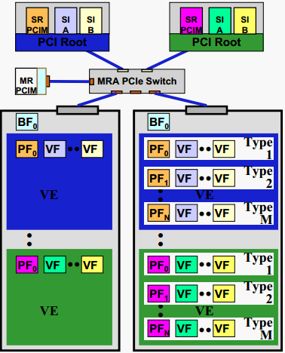
Multi-Root IOV function Types and Terms
MR Topology | MR Topology Terms
 | Virtual Endpoint (VE) is the set of physical and virtual functions assigned to an RC. Each VE is assigned to a Virtual Hierarchy (VH). Virtual Hierarchy (VH) is a fully functional PCIe hierarchy that is assigned to an RC or MR-PCIM. Note, all PFs and VFs in a VE are assigned the same VH. Base Function (BF) only 1 per EP and is used by MR-PCIM to manage an MR aware EP (e.g. assigning functions to Virtual Endpoints).

Slide 8
MRA Components
Multi-Root Aware Root Port (MRA RP)
Multi-Root Aware Device (MRA Device)
Multi-Root PCI Manager (MR-PCIM)
Multi-Root Aware Switch (MRA Switch)

Slide 9
MRA Components
Multi-Root Aware Root Port (MRA RP)
Maintain state to delineate each VH. At a high level, this amounts to a set of resource mapping tables to translate the I/O function associated with each SI into a VH and MR I/O function identifier.
Participate in the MR transaction encapsulation protocol to enable an MRA Switch to derive the VH and associated routing information.
Emit an MR Link. An MR Link is identical to the physical layer of a PCIe Link as defined in the PCI Express Base Specification.

Slide 10
MRA Components
Multi-Root Aware Root Port (MRA RP)
Implement MRA congestion management.
It does not forward TLPs for VHs where it is not the root. If this functionality is required, the MRA Root Complex may contain an embedded MRA Switch.
A Translation Agent (TA) parses the contents of a PCIe DMA request transaction (TLP)
PCIe RP and MRA RP and MRA RP Functional Block Comparison

Slide 11
MRA Components
Multi-Root Aware Device(MRA Device)
Must support the new MR-IOV DLLP protocol.
Non-IOV Devices and SR-IOV Devices do not support the MR-IOV capability and therefore are unable to participate in this protocol.
An MRA Switch must assume all responsibility for forwarding transactions and event handling on behalf of these devices through the MR-IOV topology.
The MRA Switch performs all encapsulation or de-encapsulation as appropriate.

Slide 12
MRA Components
Multi-Root Aware Device(MRA Device)
Must support the MR-IOV transaction encapsulation protocol.
The MR-IOV encapsulation protocol provides VH identification information to the MRA Switch to enable the transaction to be transparently forwarded through the MR-IOV topology without requiring modification to the PCI Express Base Specification TLP protocol or contents.

Slide 13
MRA Components
Multi-Root Aware Device(MRA Device)
It is composed of a set of Functions in each VH.
There are a variety of Function types:
BF
PF
VF
Non-IOV Function

Slide 14
MRA Components
A BF is a function compliant with this specification that includes the MR-IOV Capability. A BF shall not contain an SR-IOV Capability.
A PF is a Function compliant with the PCI Express Base Specification that includes the SR-IOV Extended Capability. Every PF is associated with a BF. The Function Offset fields in a BF’s Function Table point to the PFs.

Slide 15
MRA Components
A VF is a Function associated with a PF and is described in the Single-Root I/O Virtualization and Sharing Specification. VFs are associated with a PF and are thus indirectly as asociated with a BF.
A Non-IOV Function is a Function that is not a BF, PF, or VF. Non-IOV Functions may or may not be associated with a BF.

Slide 16
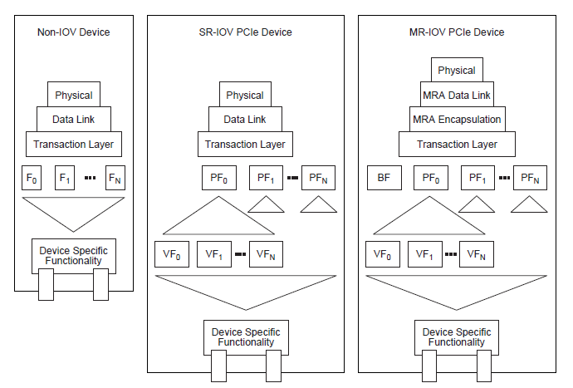
MRA Components
Non-IOV, SR-IOV, and MRA Device Functional Block Comparison

Slide 17
MRA Components
Multi-Root PCI Manager (MR-PCIM)
Each MRA component must support a corresponding MR-IOV capability. This capability is accessed and configured by the Multi Root PCI Manager (MR-PCIM).
MR-PCIM can be implemented anywhere within the MR-IOV topology.
Alternatively, MR-PCIM can manage the MR-IOV topology through a private interface provided by an MRA Switch.

Slide 18
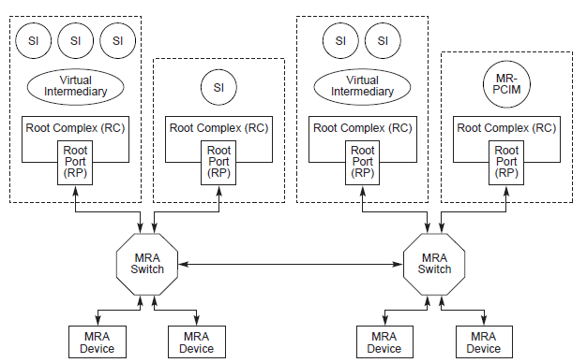
MRA Components
MRA PCIM in an MR-IOV Topology

Slide 19
MRA Components
Multi-Root Aware Switch (MRA Switch)
In contrast to a PCIe Switch, an MRA Switch is as follows:
An MRA Switch is composed of zero or more upstream Ports attached to a PCIe RP or an MRA RP or the downstream Port of an Switch.
An MRA Switch is composed of zero or more downstream Ports attached to PCIe Devices, MRA Devices, PCIe Switch upstream Ports, or PCIe to PCI/PCI-X Bridges.
An MRA Switch is composed of zero or more bidirectional Ports attached to other MRA Switches or MRA RPs.
A set of logical P2P bridges that constitute a VH.
Each VH represents a separate address space.

Slide 20
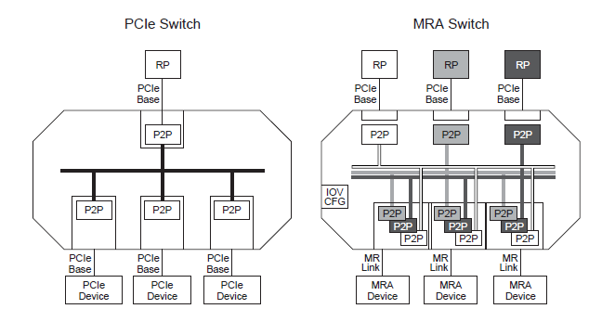
MRA Components
Virtual Switch per VH
PCIe Type1 CFG space per VH
Virtual Hot plug control, Power management tracking, Isolation, Error containment & processing per VH
VP protocol support
Insert/Remove VP label & Process Reset DLLP
PCIM interface
SW registers model for MR PCIM control of shared resources

Slide 21
MRA Endpoint
PHY
PHY
VP protocol support
Insert/Remove VP label at DLL
Process DLLP for VP RESET
Virtual Endpoint(s) per VH
Type 0 CFG space per VH
IOV capabilities within VH for SR IOV support
PCIM interface
Registers for MR PCIM control
Included in IOV CFG space of PF
DLL
DLL
PF0
PF0
PF1
PF2
Device Specific Functionality
Device Specific Functionality
PCIe 1.X Endpoint
MRA Endpoint

Slide 22
Base-SR-MR EP Progression
MR Endpoints function as SR or Base Endpoints
MR capabilities unused by non-MRA SW
ALL SR capabilities included in MR device
SR Endpoints function as Base Endpoints
IOV capability register ignored by PCIe Base SW
Goal is to minimize cost of new functions
Minimal CFG space replication Minimal logic impact of new functions

Slide 23
Virtual Plane Protocol
TLP Tag
Inserted/removed at DLL
TLP is unmodified
TLP processing uses PCIe 1.x rules
Targeted for support of 256 VP
Room for expansion to more VP or more functions
Devices may support from 1 to 256 VP
RESET DLLP
Per plane RESET DLLP
Guaranteed progress under all topology conditions
TLP messages can stall due to FC congesion
Propagates using RESET logical rules
Provides a mirror of PCIe RESET within a plane

Slide 24
Tagging TLPs
Header for all TLPs on MR link
Not included on PCIe 1.X links
Header included on all TLPs
Stable during retransmissions
Located between Sequence # and TLP Hdr
ACK/Sequence # concept remains per link
Not affected by Virtual Plane changes
Like VC today
Header covered by LCRC
VP# bits are not part of ECRC

Slide 25
RESET DLLP
Provides RESET assert/clear for up to 16 VP in single DLLP
RESET function remains a level event
RESET state is stored and maintained by each link partner
Handshake for complete reliability of RESET propagation
Guarantees buffer flush of VH within intermediate switches
Utilizes currently RSVD DLLP

Slide 26
Virtual Plane Operation
Initialization & Enumeration
MR PCIM discovers MR, SR, and Base devices
MR PCIM devices and PFs to RPs
MR PCIM programs MR switch and EP tables with MR assignments
SR SW enumerates within its Virtual Hierarchies
Traffic Flow
Base RP & Base/SR EP utilize PCIe Base protocol
MR EP inserts VP tag at DLL for appropriate PF on Base TLP
Switch utilizes VP tag to index correct Type 1 CFG headers
PCIe Base routing rules utilized within a Virtual Hierarchy
RESET
Base RP asserts RESET as TS1 or Fundamental RESET
Switch propagates on MR link as RESET DLLP within a VP
Switch propagates on Base link as TS1
MR Switch or EP receiving RESET DLLP must flush according to PCIe rules

Slide 27
Protocol Selection
MRA protocol usage must be enabled per link
Base, SR, and MR devices all coexist
Base devices must work unchanged
New protocol should either be ignored or
Enabled only after both link partners are determined as capable
Two options under consideration
Auto-negotiation at DLL
Does not modify the PHY layer training
SW enable

Slide 28
Protocol Selection
Auto negotiation modifies the DLL training SM
New DLLPs used during DLL training to indicate capabilities of link partners
New DLLPs dropped by base devices during training
Once dropped, link reverts to PCIe Base operation
SW enable controlled by MR PCIM
MR PCIM uses PCIe Base protocol for initial discovery
MRA enabled during discovery and initialization by MR PCIM

Slide 29
MR PCIM initialization

Slide 30
MR PCIM Assignment

Slide 31
SR PCIM Assignment

Slide 32
Non-Posted (NP) Request from PCIe Base to PCIe Base

Slide 33
NP from PCIe Base to MRA

Slide 34
Posted from MRA to PCIe Base

Slide 35
RESET Propagation
RP Reset completely resets VH
Equivalent to PCIe 1.X RESET functionality

Slide 36
Hot Plug in MR
MRA Switches have two Hot Plug Controllers (HPC)
Physical controller (1 per link)
Controls events on the link
Owned by MR PCIM
Virtual controller (1 per VP per link)
Controls events within a VH
Owned by SR PCIM, coordinated with MR PCIM
New registers added for MR PCIM access point
Hot Plug in MR consists of two event types
Physical events coordinated by MR PCIM and physical HPC (pHPC)
Virtual events coordinated by MR PCIM, SR PCIM, and virtual HPC (vHPC)
HPC SW interface same a PCIe Base
Utilizes PCIe Hot Plug specification within switches

Slide 37
MR Hot Plug Interfaces

Slide 38
Hot Plug Event Steps
User event initiated
Example: Slot Attention Button Press for device removal
pHPC notifies MR PCIM of event
Uses MR PCIM pHPC interface (#3)
MR PCIM initiated virtual HP events through vHPC
Uses MR PCIM vHPC interface (#2)
vHPC notifies SR PCIM(s) of event
Uses SR PCIM vHPC interface (#1)

Slide 39
Hot Plug Event Steps
SR PCIM processes event and updates state of vHPC
Uses SR PCIM vPHC interface (#1)
vHPC notifies MR PCIM of state change for that vHPC
Uses MR PCIM vHPC interface (#2)
MR PCIM processes all state changes and updates state of pHPC
Uses MR PCIM pHPC interface (#3)
pHPC indicates device is safe for removal
Example: Slot power removed & LED state change

Slide 40
Hot Removal Event Initiated

Slide 41
Hot Removal Coordination

Slide 42
Hot Removal Completion

Slide 43
Reference
Multi-Root I/O Virtualization and Sharing Specification Revision 1.0
Dennis Martin, “Innovations in storage networking: Next-gen storage networks for next-gen data centers,” in Storage Decisions Chincago presentation titled, 2012.
http://www.pcisig.com/developers/main/training_materials/get_document?doc_id=e3da4046eb5314826343d9df18b60f083880bf7b
http://www.pcisig.com/developers/main/training_materials/get_document?doc_id=ee6c699074c0b2440bfac3abdecb74b3d89821a8
http://www.pcisig.com/developers/main/training_materials/get_document?doc_id=656dc1d4f27b8fdca34f583bdc9437627bc3249f

